Slide 1

CSE 350 Digital Electronics and Pulse Techniques
Diode Logic
Course Instructor: Shomen Kundu (SDU)
Mail: shomen.kundu@bracu.ac.bd
Desk: 4N166

Slide 2
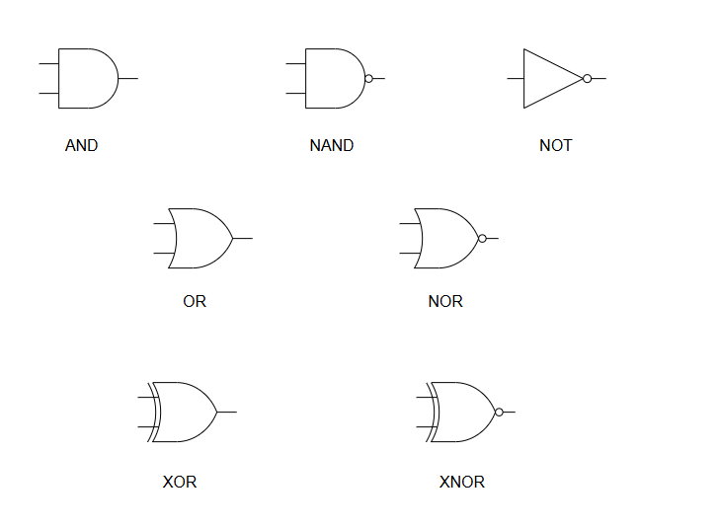
Abstract of Logic Gate:
This gates are abstract, because they just represent logical operations.

Slide 3
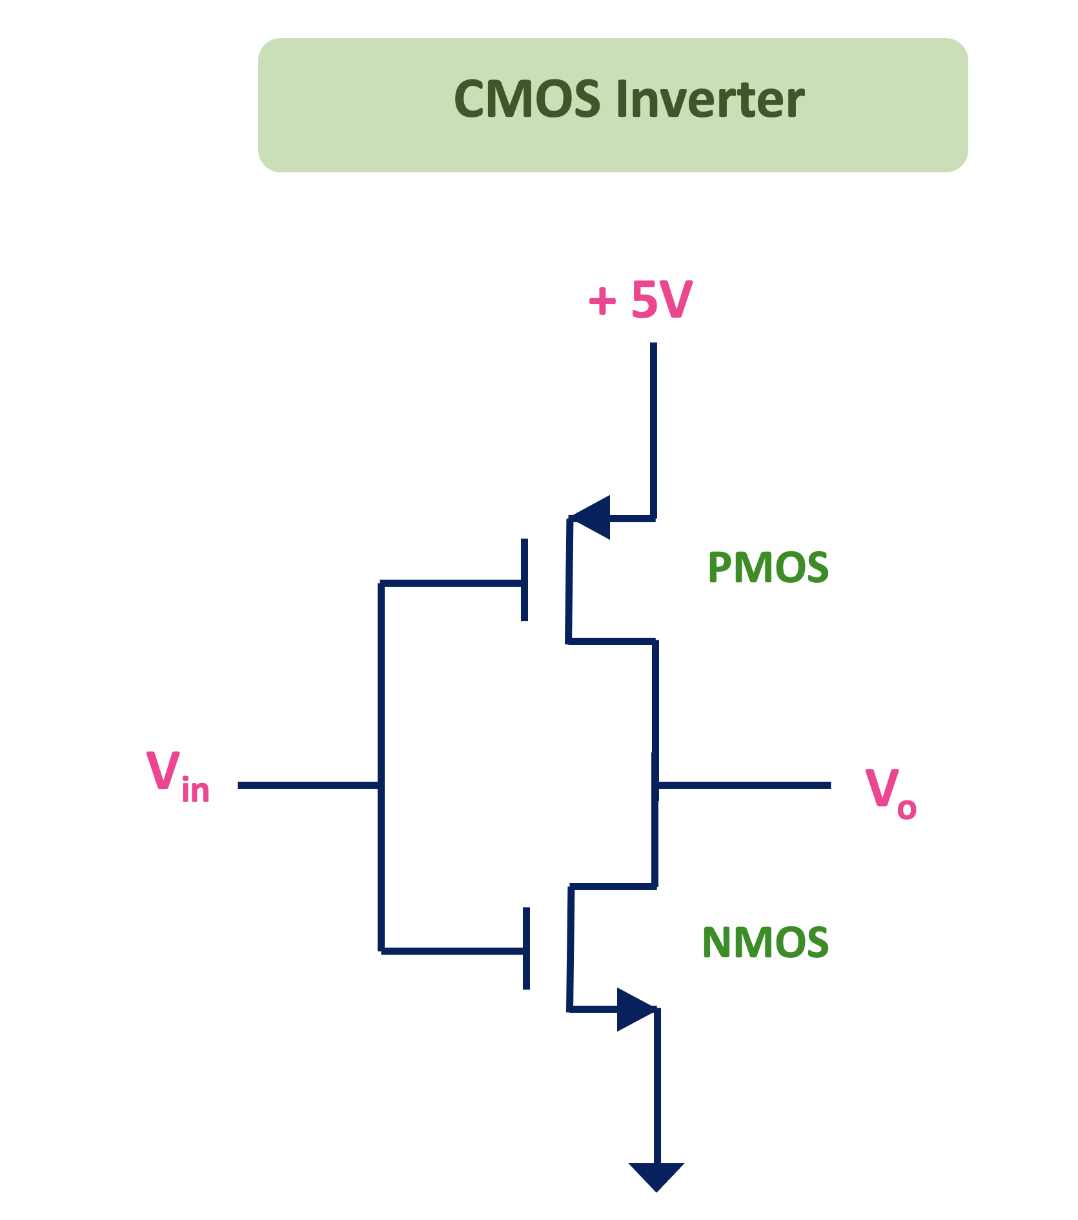
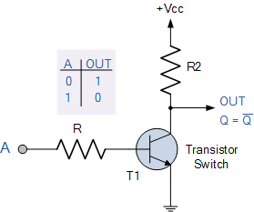
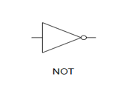
Logic families

Slide 4
Logic families
Digital Logic Families
Bipolar logic families
(electron and hole both are used as charge carrier)
Example: BJTs
Unipolar logic families
(Only one type of charge carrier dominates)
Example: MOSFET, JFET
i. PMOS logic families
ii. NMOS logic families
iii. CMOS logic families
Saturated
(saturation and Cutoff)
Unsaturated
(Active & Cutoff)

Slide 5
Logic families
Saturated Logic Family: Uses Saturation & Cutoff region of a BJT for implementation of logic states.
Resistor Transistor Logic (RTL)
Diode Transistor Logic (DTL)
Direct Coupled Transistor Logic (DCTL)
Integrated Injection Logic (IIL)
High Threshold Logic (HTL)
Transistor-Transistor Logic (TTL)
Unsaturated Logic Family: Uses Active & Cutoff region of a BJT for implementation of logic states.
Schottky TTL
Emitter Coupled Logic (ECL)

Slide 6
Logic families
Unipolar Logic Family: JFET, MOSFET etc. single charge carrier-based transistor logic families.
PMOS Logic Family
NMOS Logic Family
CMOS Logic Family

Slide 7
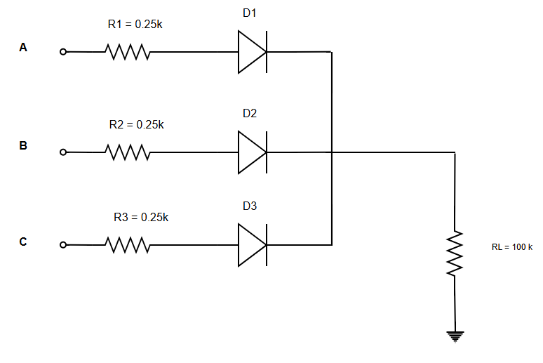
Diode logic
OR Gate

Slide 8
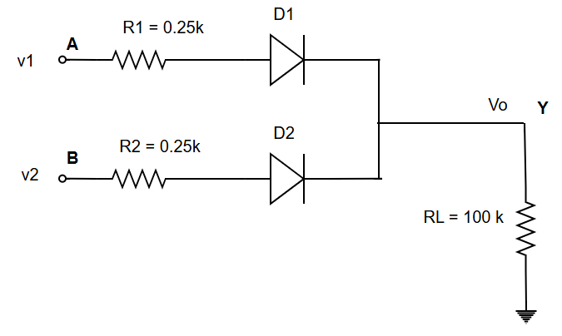
Diode logic
Two input OR Gate
A | B | V1 | V2 | Vo | Y
0 | 0 | 0V | 0V
0 | 1 | 0V | 5V
1 | 0 | 5V | 0V
1 | 1 | 5V | 5V
Assume: Logic 1 means 5 V on input side. Logic 0 means 0 voltage/GND

Slide 9
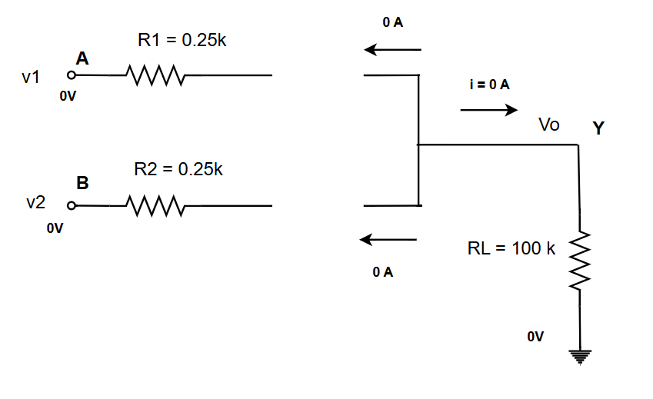


Diode logic
Case 1: A = 0, B = 0
First thing to check whether diodes are on or off.
FACT: We need at least 0.7 V to turn on any diode.
Conclusion: D1 and D2 are OFF.
$$\frac{Vo −0}{RL}=i=0 =>Vo=0 V$$
$$Y=0 ( logic)$$

Slide 10
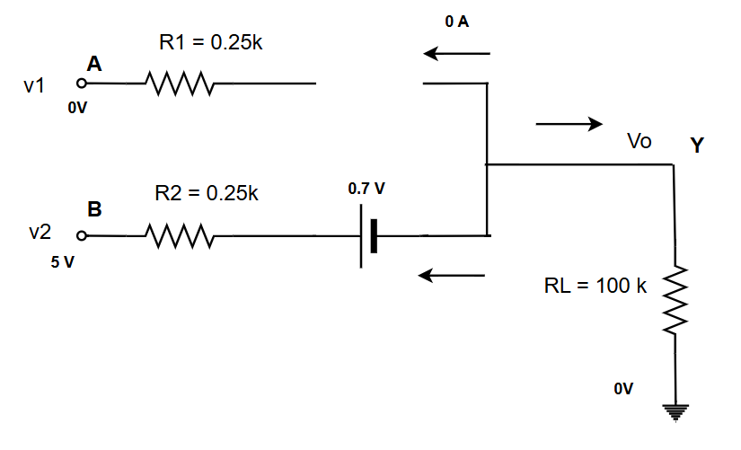
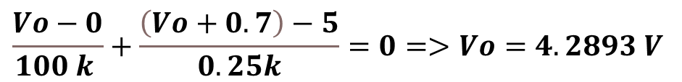

Diode logic
Case 2: A = 0, B = 1
First thing to check whether diodes are on or off.
# Here: D1 will be OFF and D2 will be ON
$$\frac{Vo−0}{100 k }+\frac{\left(Vo+0.7\right)−5}{0.25k}=0=>Vo=4.2893 V$$
$$Y=1 ( logic)$$

Slide 11
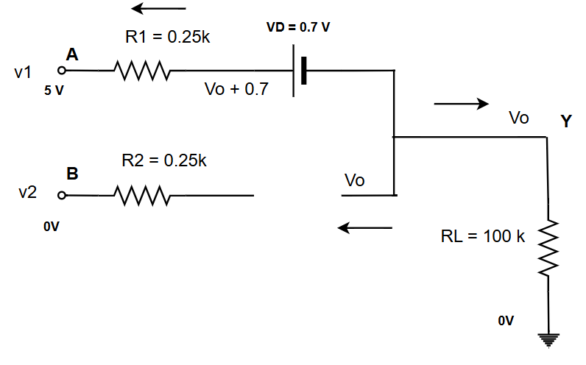


Diode logic
Case 3: A = 1, B = 0 ( symmetrical to case 1 )
First thing to check whether diodes are on or off.
# Here: D1 will be ON and D2 will be OFF
$$\frac{Vo−0}{100 k }+\frac{\left(Vo+0.7\right)−5}{0.25k}=0=>Vo=4.2893 V$$
$$Y=1 ( logic)$$

Slide 12
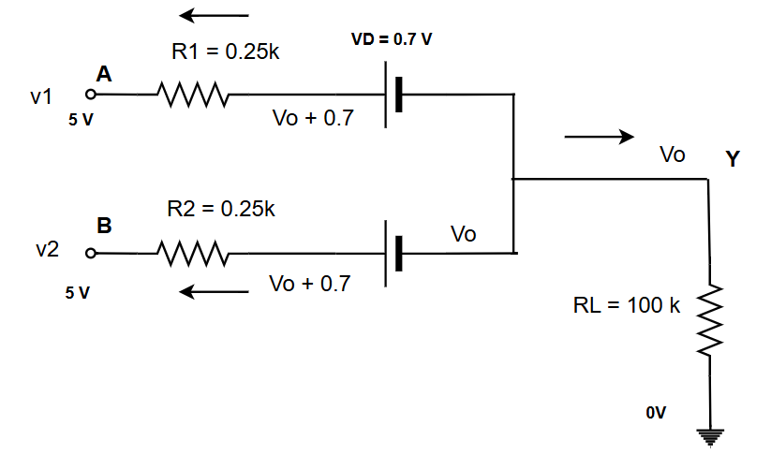
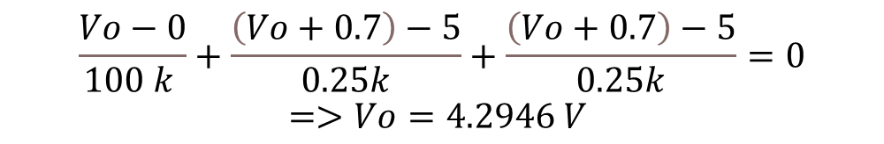

Diode logic
Case 4: A = 1, B = 1
First thing to check whether diodes are on or off.
# Here: D1 will be ON and D2 will be ON
$$\frac{Vo−0}{100 k }+\frac{\left(Vo+0.7\right)−5}{0.25k}+\frac{\left(Vo+0.7\right)−5}{0.25k}=0$$
$$=>Vo=4.2946 V$$
$$Y=1 ( logic)$$

Slide 13
Diode logic
A | B | V1 | V2 | Vo | Y
0 | 0 | 0V | 0V | 0 V | 0
0 | 1 | 0V | 5V | 4.2893V | 1
1 | 0 | 5V | 0V | 4.2893V | 1
1 | 1 | 5V | 5V | 4.2946 V | 1
Two input OR Gate Findings
#4.28 V , 4.29 V
# logical High and Low can be
Different at input and output side
VOH = 4.28 V
( lowest of the outputs values
that can be considered as logic 1 )

Slide 14
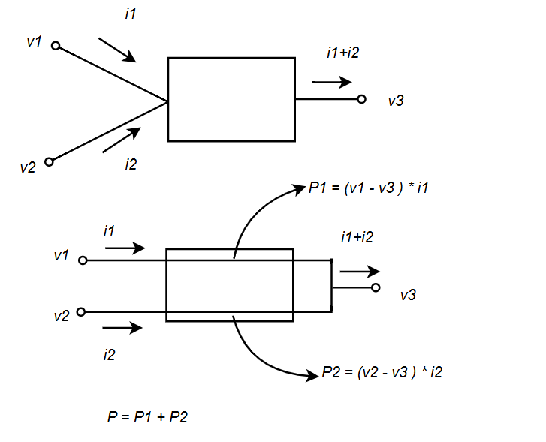
Power Dissipation Calculation
Theory:

Slide 15
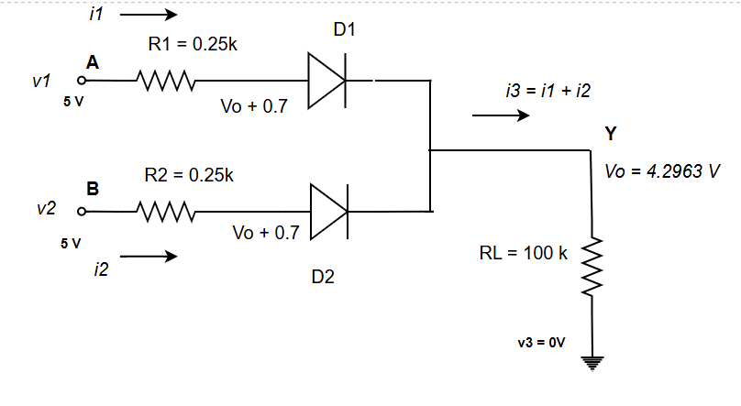

Max Power Dissipation
Max power dissipation will be in the case 4
$$i1= \frac{5−( v0+0.7)}{0.25 k}$$
$$i2=i1$$
$$P1=\left(5−0\right)∗i1$$
$$P2=\left(5−0\right)∗i2$$

Slide 16
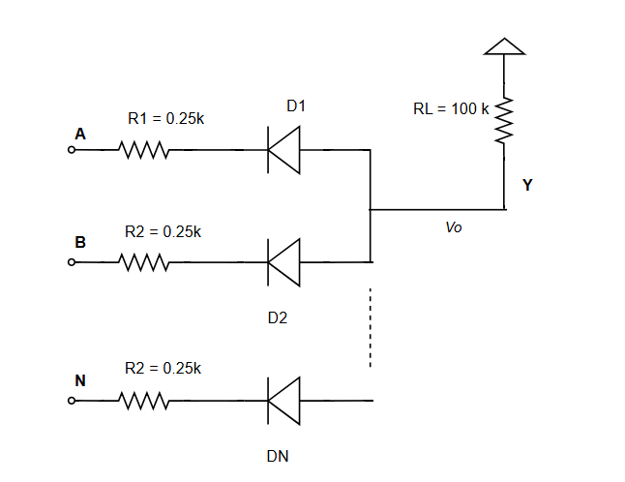
Diode logic
AND gate:

Slide 17
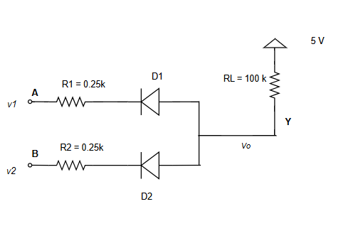
Diode logic
Exercise: Analysis the four possible input and fill the table. Also find the V_{OL} for this circuit.
A | B | V1 | V2 | Vo | Y
0 | 0 | 0V | 0V
0 | 1 | 0V | 5V
1 | 0 | 5V | 0V
1 | 1 | 5V | 5V
Hints: Logical low voltage at the output side --→ Highest voltage for which the output is considered to be 0 or logic low.

